Slide 1
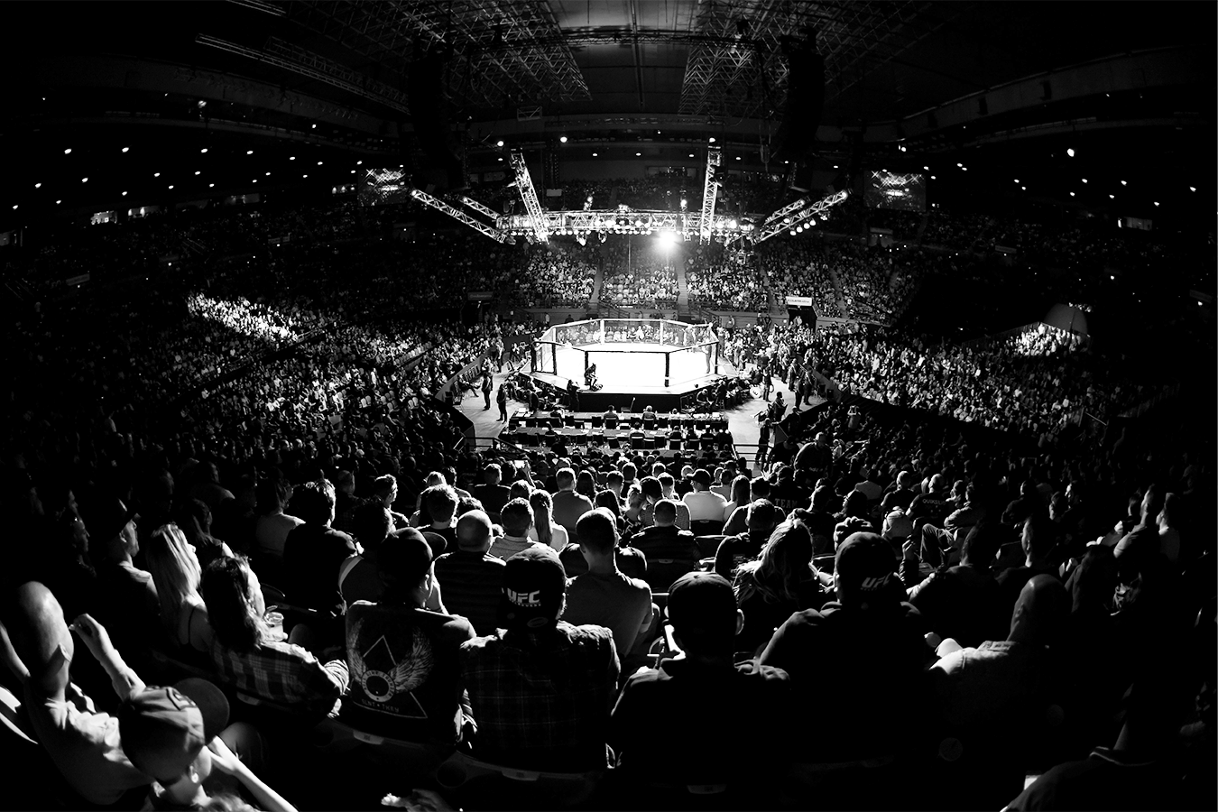

UFC Combat Strategy Recommendation Model
Team B3
Avi Dhruva, Brynjolfur Brynjolfsson, Haoyang (Steven) Zhang,
Mohammed Alshubaibi, Zhiyu (Eric) Chen

Slide 2
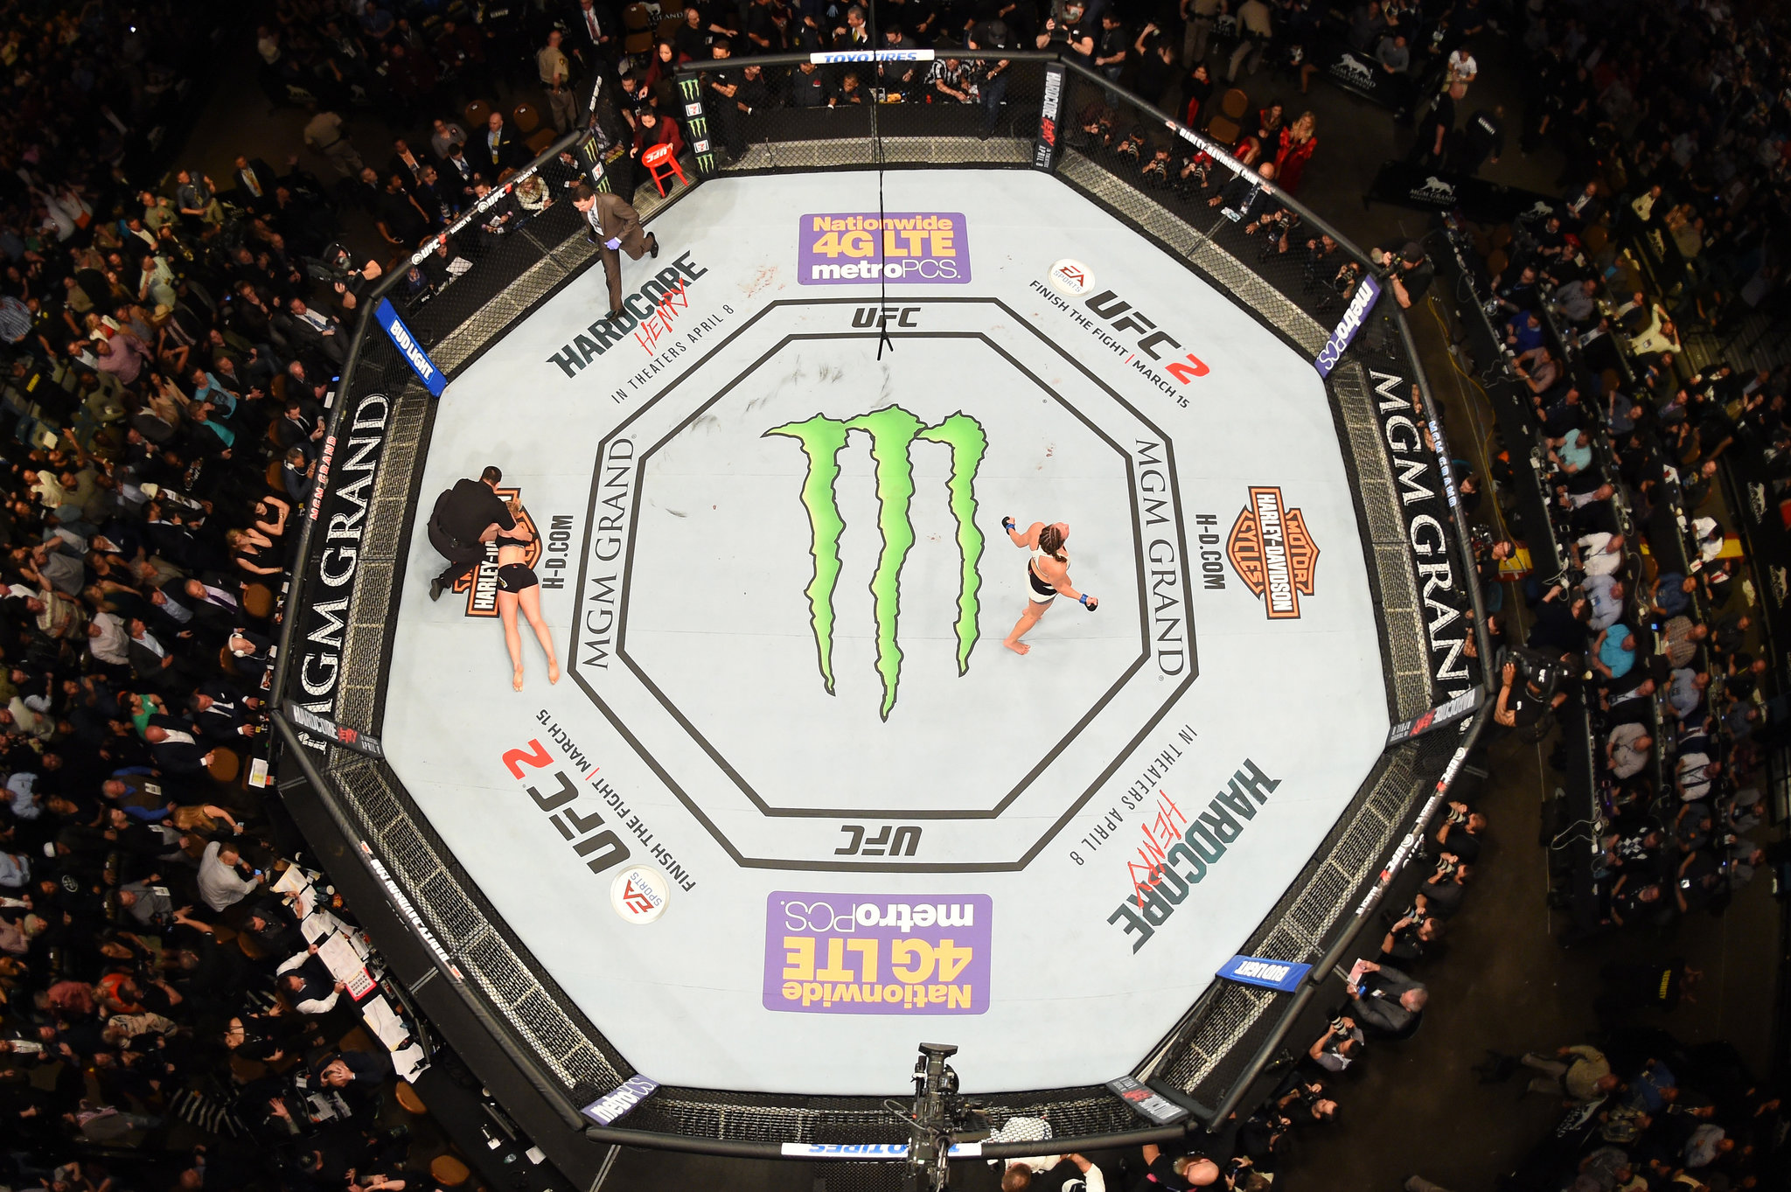
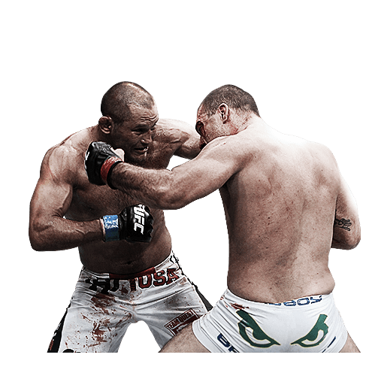
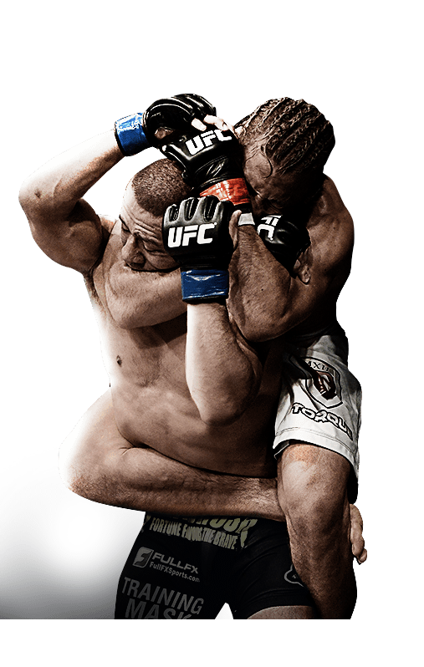
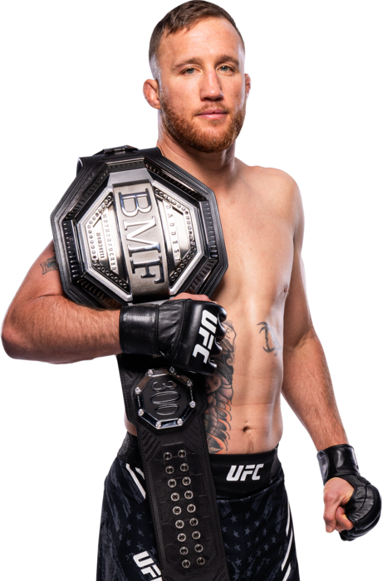
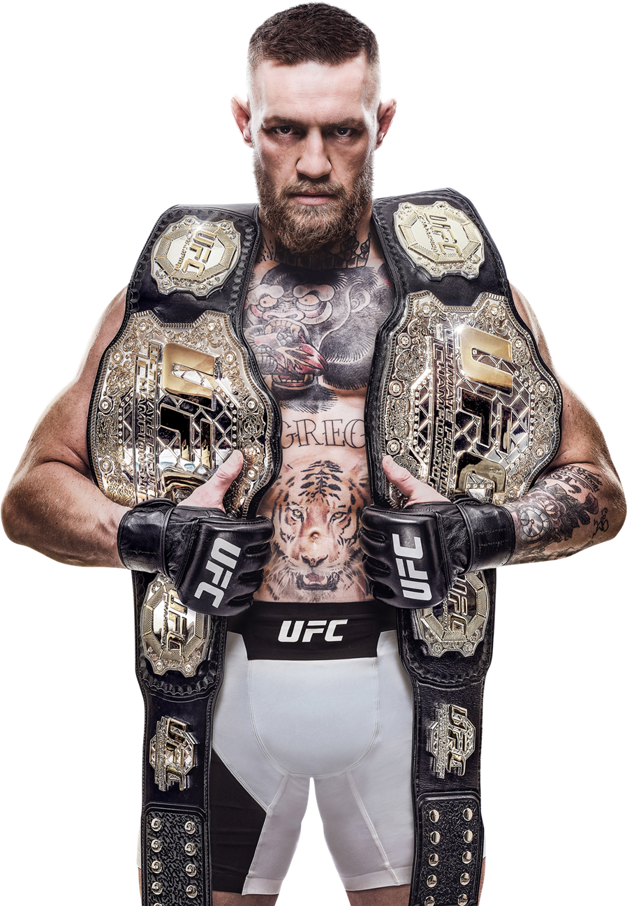
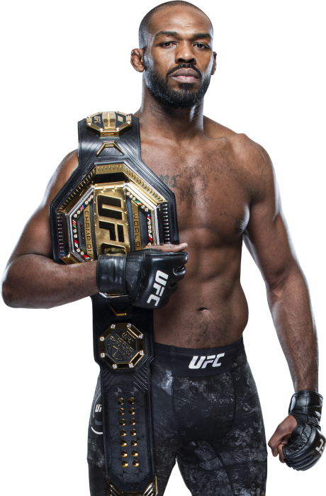
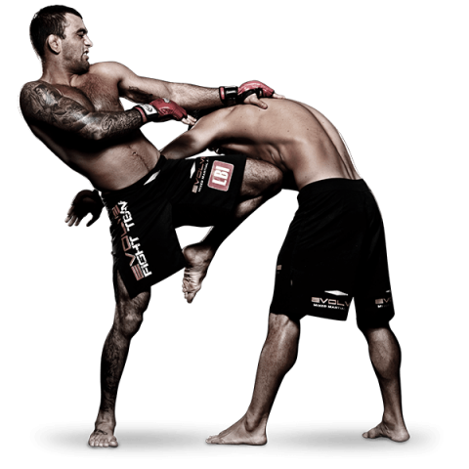
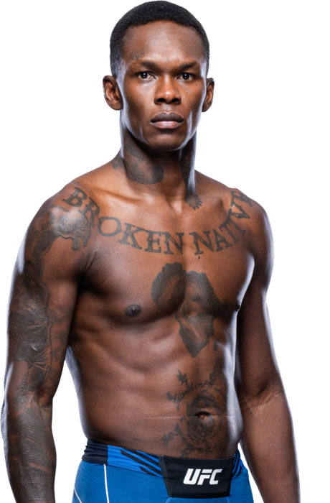
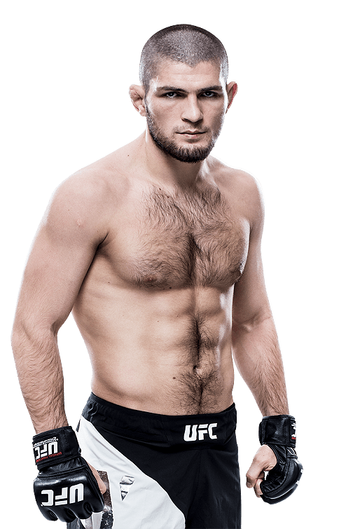
What is the UFC?
About UFC
Fighting Styles
The Ultimate Fighting Championship (UFC) is the leading organization in the sport of mixed martial arts (MMA).
Striker
Octagon
Total Active # Fighters
Grappler
578
Hybrid Combination / Balanced

Slide 3
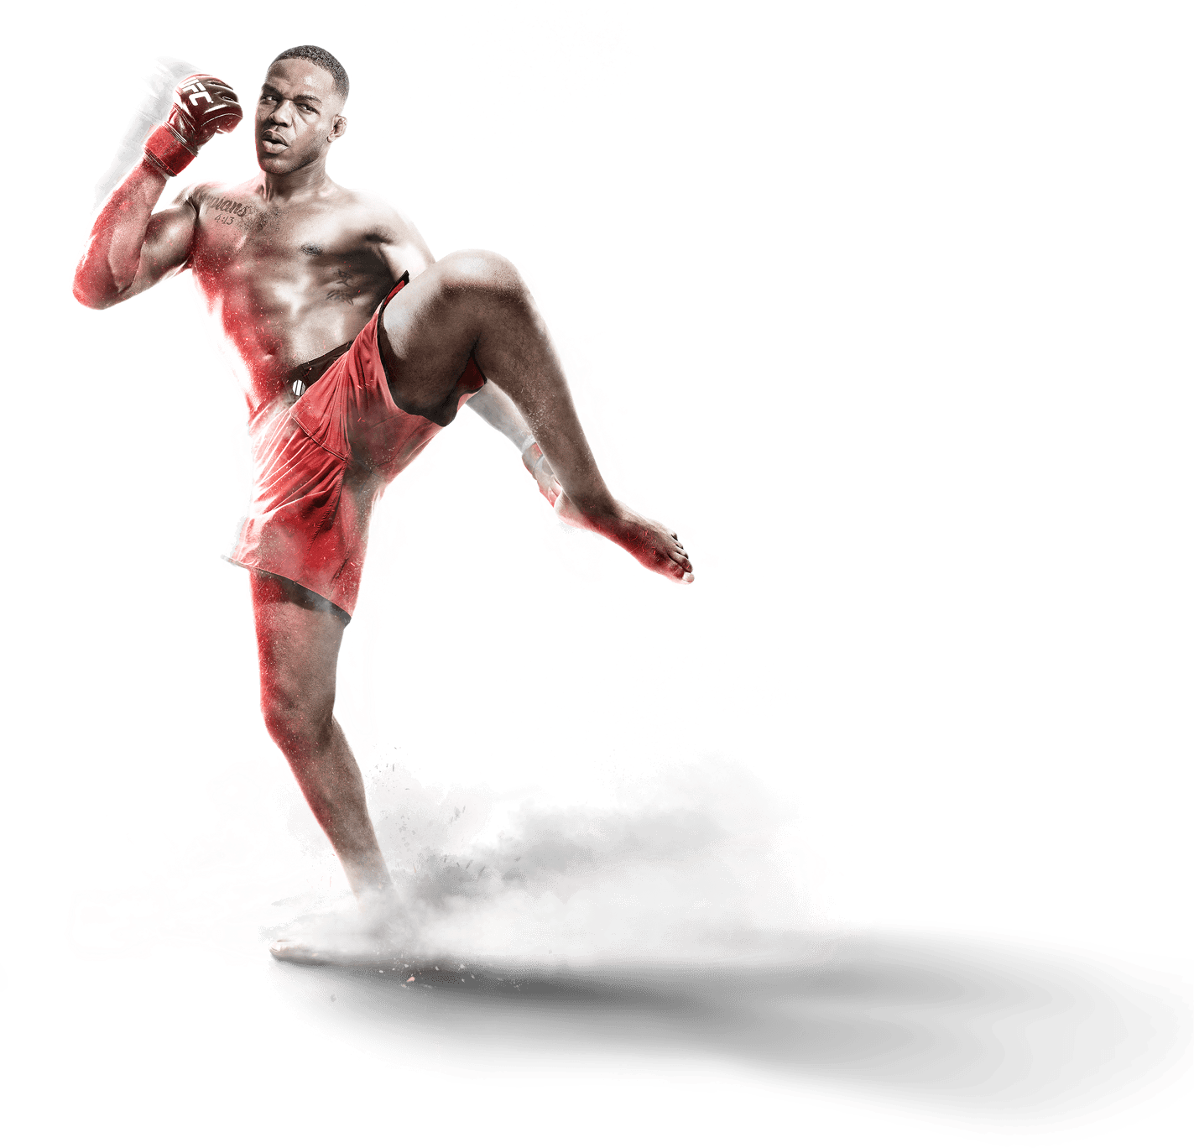
Agenda
1
Dataset Selection & Our Initial Goals
2
Data Preprocessing
3
Model Construction
4
Application & Demonstration
5
Potential Implications & Improvements

Slide 4
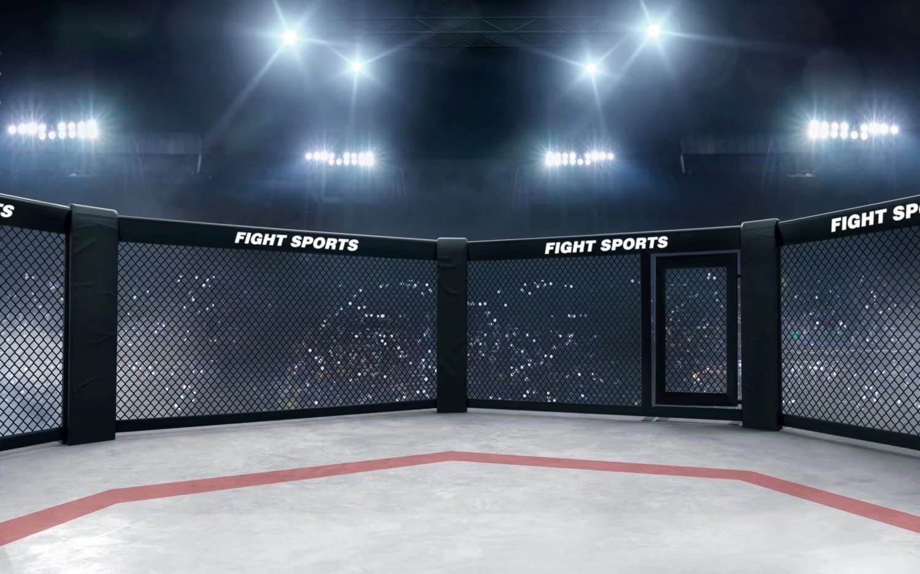
Dataset Selection & Our Initial Goals

Slide 5



Initially Explored Three Datasets, UFC was Chosen
Dataset:
Uber and Lyft Dataset Boston, MA
Idea:
Explore what variables related to weather conditions influence the
price of each Uber and Lyft ride
Dataset:
Online Food Delivery Preferences-Bangalore region
Idea:
Explore building a prediction model to predict the percentage of
having a delayed food order from UberEats
Dataset:
UFC-Fight historical data from 1993 to 2021
Idea:
Exploring building a recommendation model on the best fight style to take on given your weight class

Slide 6
Original Dataset - 6012 Observation / 144 Features
Dataset Statistics
Fighter
Average Knockdowns
Average Takedowns Attempted
Average Strikes Attempted
Average Submission Attempts
Average Control Time
Average Legkicks Attempted
Red Fighter
Blue Fighter
Fight-Style
Winner
Average Strikes Difference
Average Takedown Difference
Average Control Time Difference
Fighter
Game
1,334
Observations
3,788
6
Features
30
Utilized for
Cluster
Model

Slide 7
Data Preprocessing

Slide 8
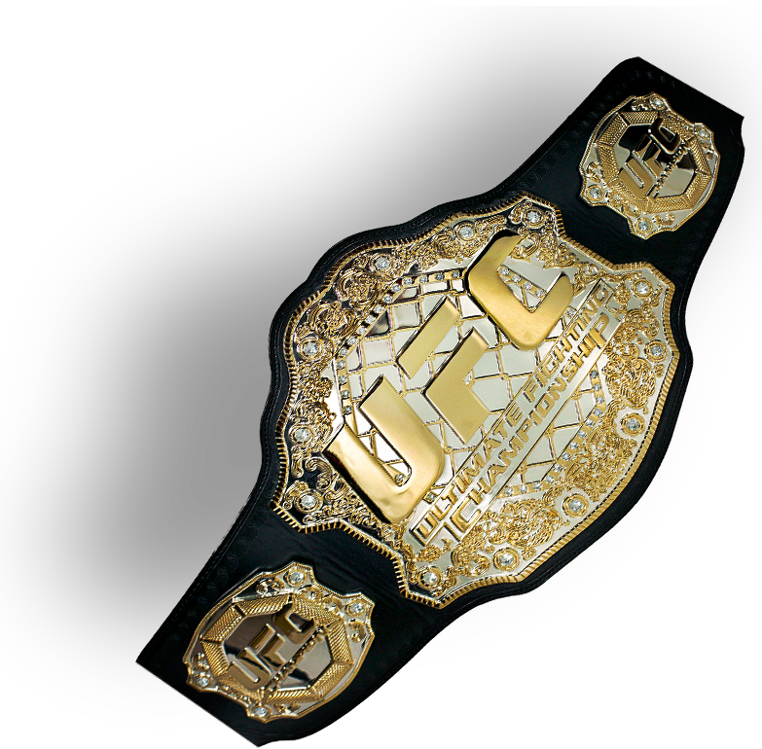
Cleaning the Data to Start Creating our Models
Removed Empty Observations
Removed Weight Classes with Few Data Points
Fixed cell formatting
Clean Data
Took Competitive Advantage Based Variables
Rearranged row formatting

Slide 9
Splitting the Dataset to Make a Portfolio for All Fighters
Fighter | Weight Class
Adrian Yanes | Bantamweight
Gustavo Lopez | Bantamweight
Trevin Giles | Middleweight
Roman Dolidze | Middleweight
Tai Tuivasa | Heavyweight
Red Fighter | Blue Fighter | Weight Class
Adrian Yanez | Gustavo Lopez | Bantamweight
Trevin Giles | Roman Dolidze | Middleweight
Tai Tuivasa | Harry Hunsucker | Heavyweight

Slide 10
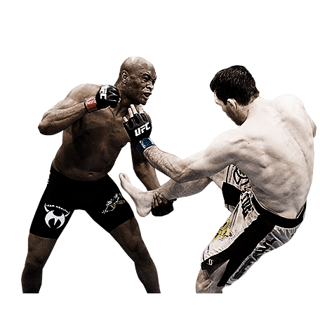
Deciding Variables to Incorporate for Clustering
Rules and regulations
Average Knockdown Attempts
Decided to choose three variables for each fighting style we predicted (Strikers and Grapplers)
Decided to split into three clusters to analyze if there were any patterns for hybrid fighters
To ensure our variables captured the these fighting styles, we ran the correlation matrix
Average Significant Strikes Attempted
Average Legkicks Attempted
Striker
Hybrid
Average Takedown Attempts
Average Control Time
Grappler
Average Submission Attempts

Slide 11
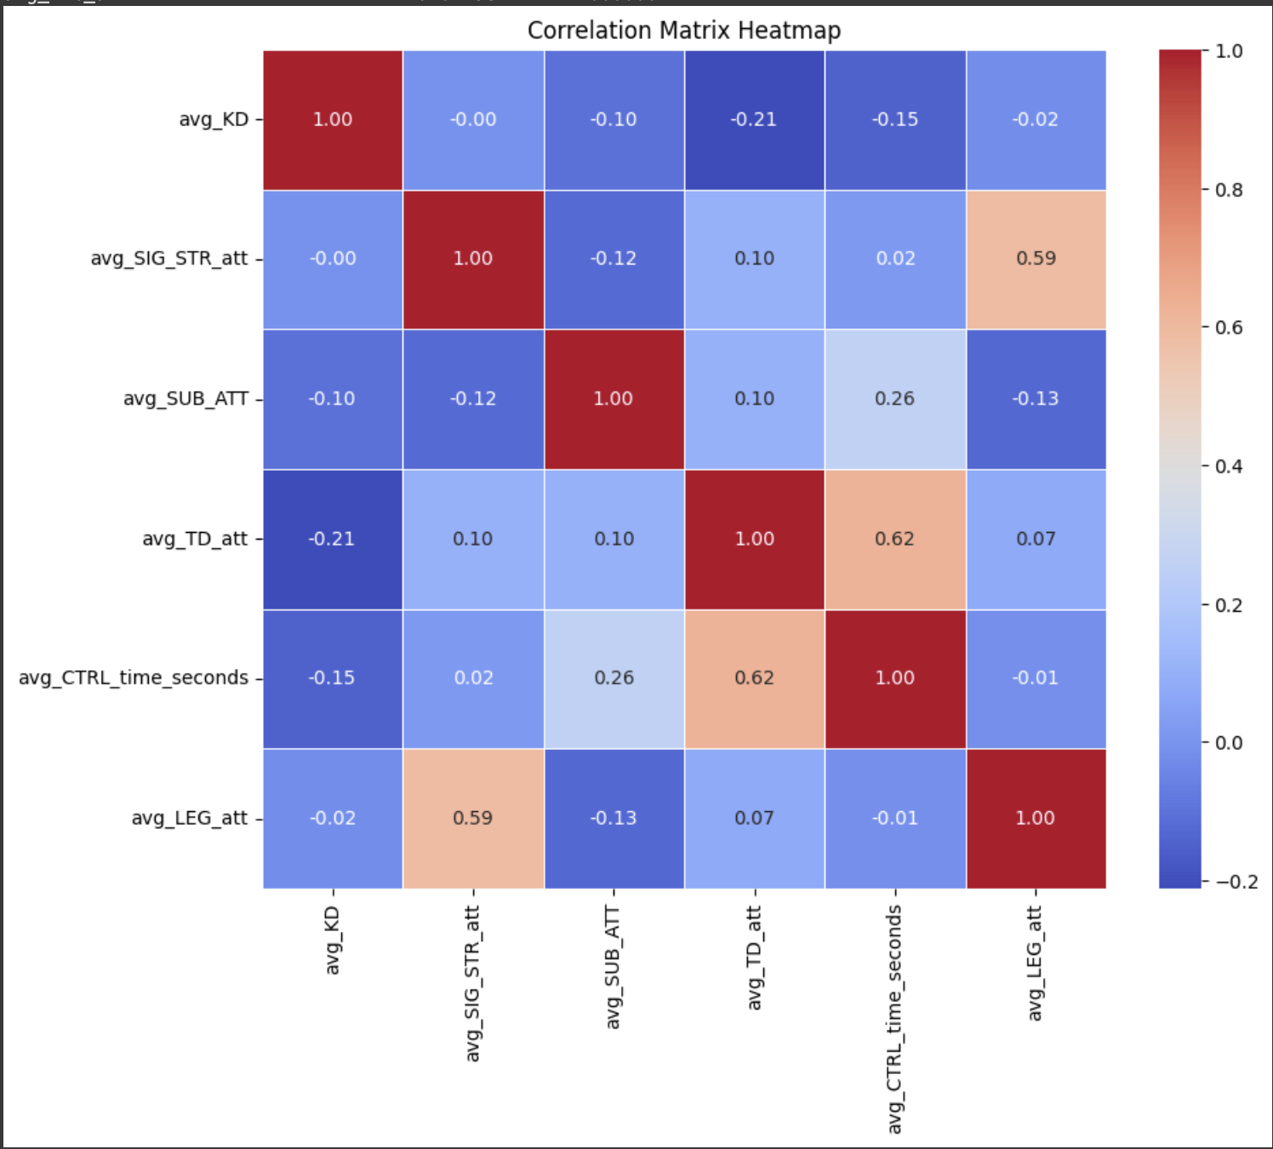
Clear Correlation Between Selected Variables

Slide 12
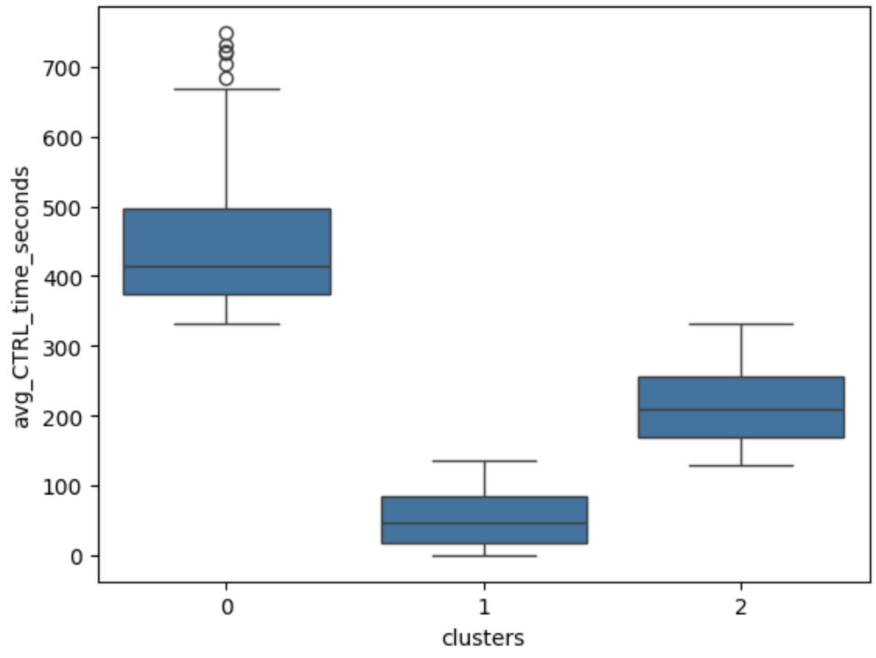
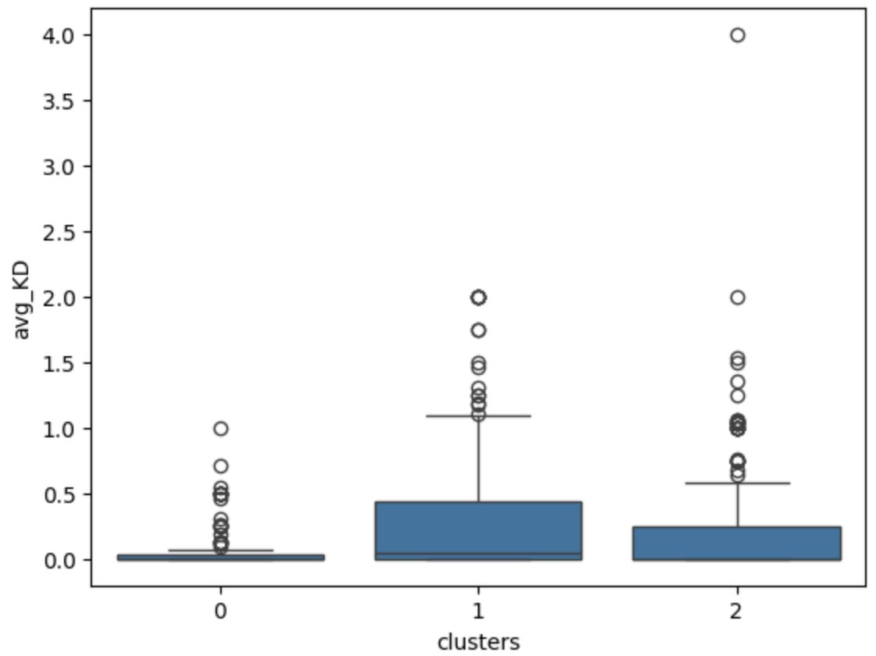
Interpreting Our Clusters and Assigning Fightstyles
Grapplers belong to this cluster due to high ground metrics
Strikers reside in this cluster, due to high strike/legkick metrics
Fighters with balanced or hybrid fighting styles belong to this cluster
Cluster 0
Cluster 1
Cluster 2
Notes:
Cluster 0: Grapplers
Cluster 1: Strikers
Cluster 2: Balanced

Slide 13
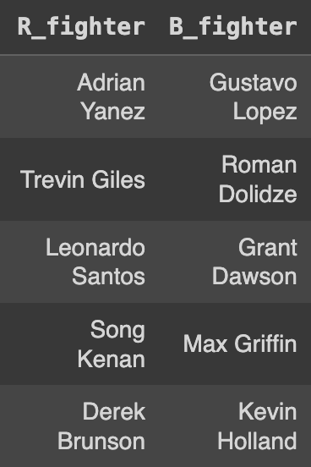
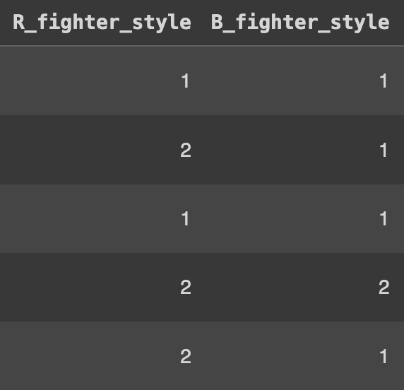
Fighting Style Clusters is Linked with Each Athletes and New Variables Showing Competitive Advantages are Created
After we have the clusters, we link the two tables (game statistics table and fighter statistics table)
Associate each blue side and red side fighter with what fighting style they have
avgsigstrlanded_diff
The competitive advantage that the red side fighters have on having significant strikes
avgctrltime_diff
The competitive advantage that the red side fighters have on controlling the opponents
Notes:
When developing our final model, many original variables are what we used to group the fighters
If we keep these variables as they are, it will be highly correlated with the clusters itself
Create new variables that shows the competitive advantage between fighters to decrease correlation between variables.

Slide 14
Model Construction

Slide 15
F1 Score is Selected as the Performance Measure
Measuring Performance
Weight Class Split
Accuracy isn’t sufficient
FP and FN are costly — want to minimize
F1 score takes both into consideration, hence it is selected as the performance measure
Weight classes are designed to separate various types of fighters and ensure an equal playing field for both fighter
The success of each respective fighting style differs across different weight classes
Hence we split the dataset into each weight class
 | Predict Blue Wins | Predict Red Wins
Actual Blue Wins | TN | FP
Actual Red Wins | FN | TP

Slide 16
Decision Tree Gives Us Good Interpretability for Coaches with Above Average Performance
“Our goal is for coaching teams to be able to use the model to identify what is the best strategy to use for an upcoming fight/give areas of improvement that can be the most effective”
Decision Trees
Weight Class | Tree Depth | Performance (F1 Score)
Bantamweight | 2 | 0.754
Lightweight | 1 | 0.772
Middleweight | 2 | 0.820
Heavyweight | 1 | 0.781
Best for interpretability if controlled for complexity
Shows what direction to train clearly

Slide 17
Demonstration of Decision Tree (Bantamweight)
avggroundlanded_diff <= -8.105
gini = 0.485
samples = 307
value = [127,180]
class = Bantamweight, Red
avgtdatt_diff <= 0.75
gini = 0.405
samples = 39
value = [28,11]
class = Bantamweight, Blue
avggroundlanded_diff <= -6.938
gini = 0.466
samples = 269
value = [99,169]
class = Bantamweight, Red
gini = 0.298
samples = 33
value = [27,6]
class = Bantamweight, Blue
gini = 0.278
samples = 6
value = [1,5]
class = Bantamweight, Red
gini = 0.486
samples = 48
value = [28,20]
class = Bantamweight, Blue
gini = 0.437
samples = 220
value = [71,149]
class = Bantamweight, Red

Slide 18
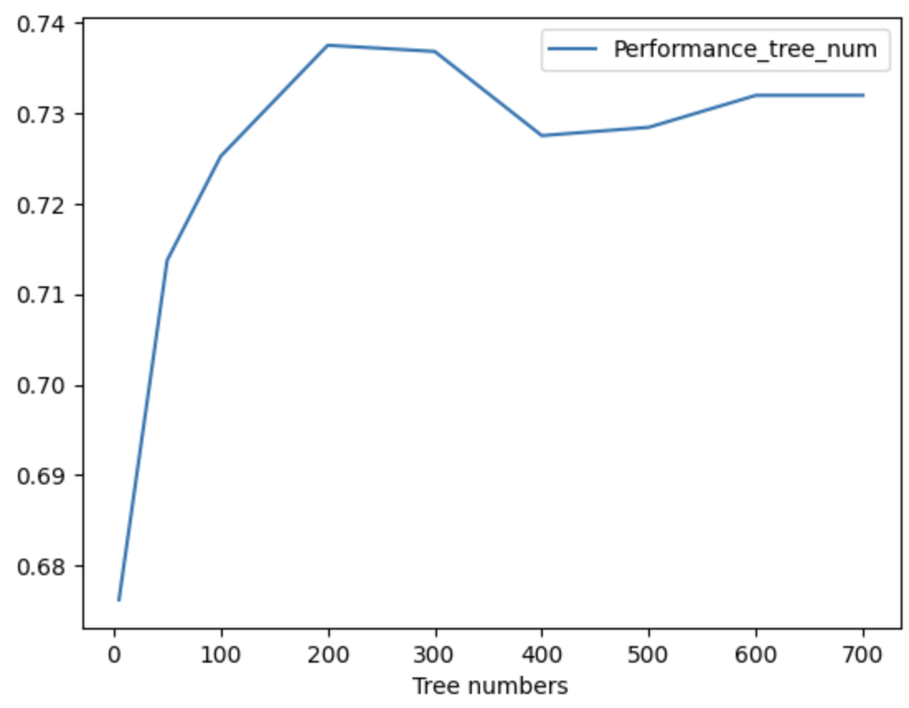
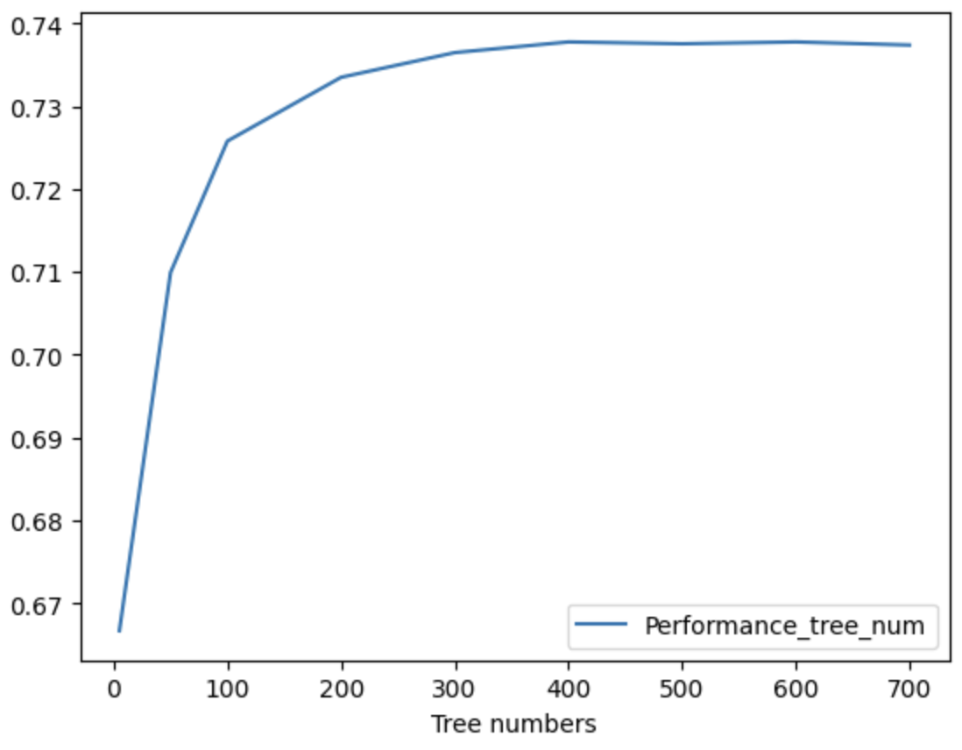
Performance Maximizes with Tree Number Around 200 - 400
Selected range: [200, 250, 300, 350, 400, 450, 500]

Slide 19
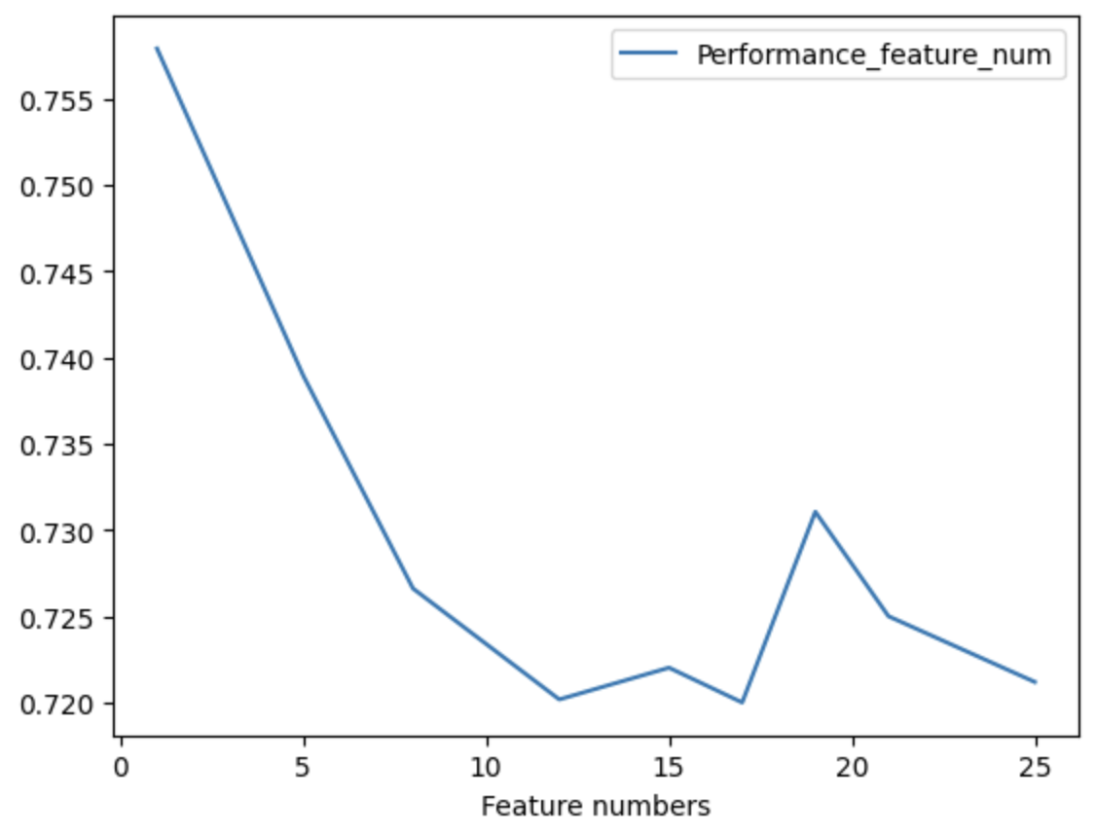
Number of Variables Considered by Each Tree Should Be Minimal
Variable Selection for Decision Trees
Performance seems to be decreasing when the number of variables considered in each decision tree increases. Therefore, the finalized model should only consider a small number of predictors.
In theory, the number of predictors considered should be around the square root of the total number of predictors, we have around 25 predictors in total in our dataset.
Selected range: [1, 2, 3, 4, 5]

Slide 20
Random Forest Improves Model Performance Slightly in Some Weight Classes but with Trade Offs
Create Loops Iterating Over Each Weight Class
PLUS
Model Performance Comparison
Good Performance Less Prone to Overfit
Decision Tree
Random Forest
Create Dictionaries to Record Estimators
0.754
0.796
Bantamweight
0.772
Lightweight
0.746
Weight Class | N_Estimators | N_Features
Bantamweight | 450 | 1
Lightweight | 500 | 1
Middleweight | 400 | 3
Heavyweight | 300 | 1
DELTA
0.820
Middleweight
0.800
Low Interpretability
0.781
Heavyweight
0.773
Notes:
After deciding on what is the range of parameters to iterate through:
Create loops to iterate over each of weight classes with the given range
Create dictionaries to record the estimators that gives the best model performance as well as what model it belongs to
Return the output for each weight classes

Slide 21
K-NN Model Produces Similar Performance Level Compared to DT & RF
Similar fights should have similar outcomes
Model Performance Comparison
Range of number of neighbours to iterate:
From 1 to ¾ of the dataset
(train test split ratio of 1 to 3)
Decision Tree
K-NN
0.754
0.758
Bantamweight
0.772
Lightweight
Weight Class | N_Neighbours
Bantamweight | 49
Lightweight | 117
Middleweight | 129
Heavyweight | 48
0.768
0.820
Middleweight
0.793
0.781
Heavyweight
0.790
Notes:
Similar fights should have similar outcomes:
e.g. if the same two fighters that are not similar to each other and are different in skill levels fight 10 fights
the outcome should be predictable
Range of number of neighbours to iterate: from 1 to ¾ of the dataset (train test split ratio of 1 to 3)

Slide 22
Application & Demonstration

Slide 23


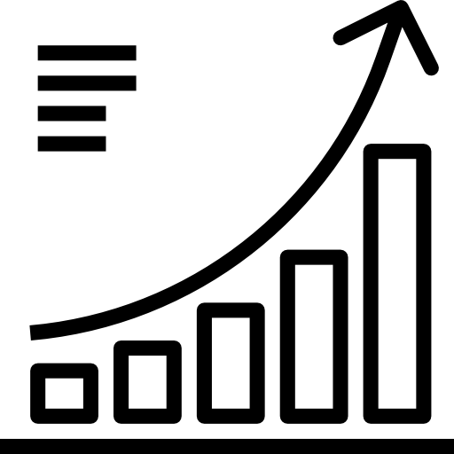
Our Model Strives to Help Coaches and Fighters Maximize Success
Strategic Planning
Understand opponent's strengths and weaknesses
Tailor specific training strategies
Fight Selection
Assess potential matchups
Make informed decisions about which fights to pursue
Performance Analysis
Analyze past fighting performances
Identify trends and areas for improvement

Slide 24
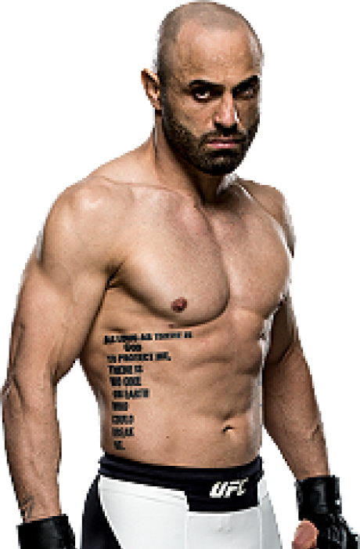
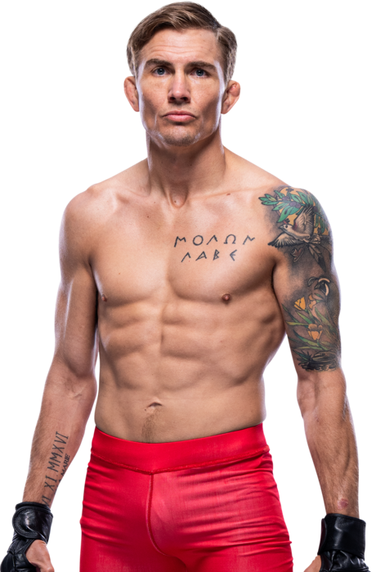
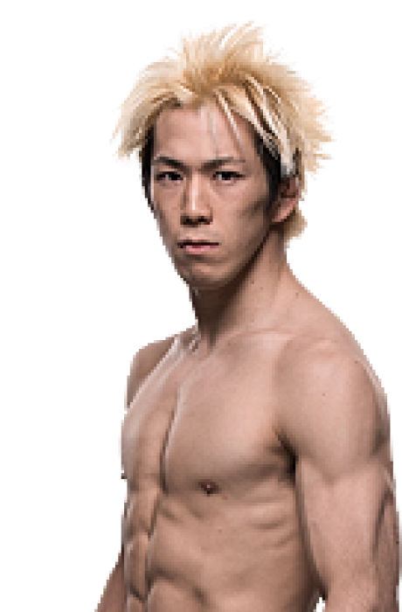
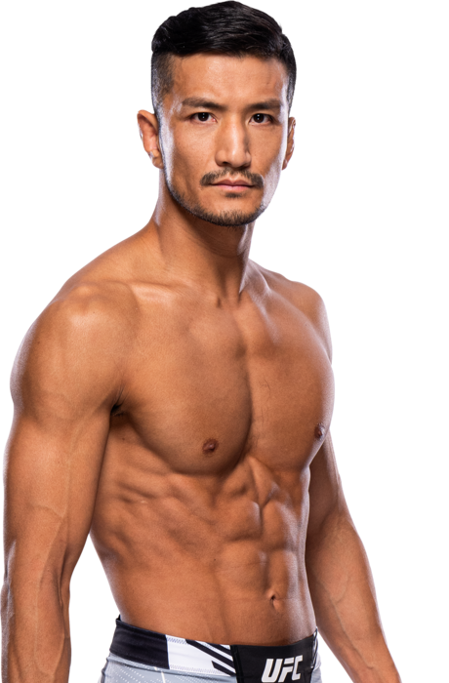
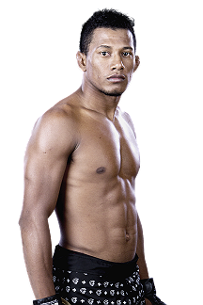
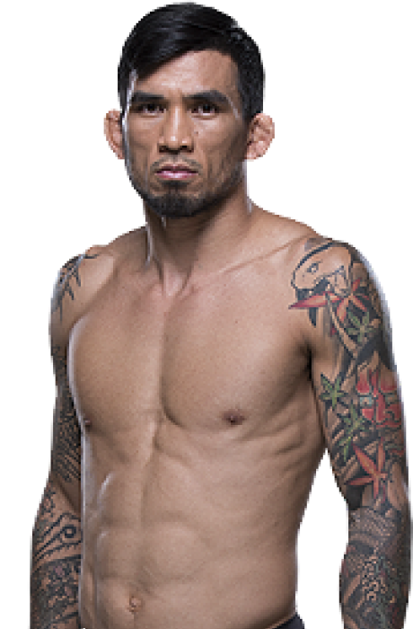
How The Model Works In Real Game Scenarios
VARIABLES
GAME 1
GAME 2
GAME 3
Fighting Style
V.S
V.S
V.S
Avg_kd_diff
Avgsigstrpct_diff
Manvel Gamburyan
Cody Gibson
Michinori Tanaka
Kyung Ho King
Luri Alcantara
Russell Donae
Striker
Striker
Balanced
Balanced
Striker
Balanced
Avgtdpct_
diff
-0.50
0.00
0.75
0.085850
0.060000
0.079453
Avgtsubat_
diff
0.298457
-0.137500
0.164062
0.011719
-1.000000
-0.312500
Notes:
When facing a new game:
enter the fighting style of both fighters, what is the competitive advantage of stikes attempted, control time, …etc
the model will return a predicted winner
Use three games from Bantamweight class as an example:
on the right is the predicted results using each model and the actual result

Slide 25
Prediction Results Are Consistent With Expected Performance
GAME 1 Predictions
GAME 2 Predictions
GAME 3 Predictions
Actual Winner:
RED
Actual Winner:
BLUE
Actual Winner:
RED
DT Pred:
RED
DT Pred:
BLUE
DT Pred:
RED
RF Pred:
RED
RF Pred:
BLUE
RF Pred:
RED
KNN Pred:
RED
KNN Pred:
RED
KNN Pred:
RED
Notes:
When facing a new game:
enter the fighting style of both fighters, what is the competitive advantage of stikes attempted, control time, …etc
the model will return a predicted winner
Use three games from Bantamweight class as an example:
on the right is the predicted results using each model and the actual result

Slide 26
Potential Implications and Improvements

Slide 27



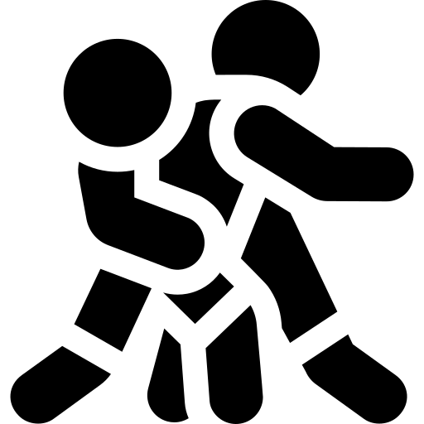
Dataset Factors That Could Have Helped Us
Finding datasets with more observations
More promotions Vs. Longer period of time
Finding a variable with an equal number of striking and grappling variables
We could have found a dataset with an equal win rate for red and blue fighters

Slide 28
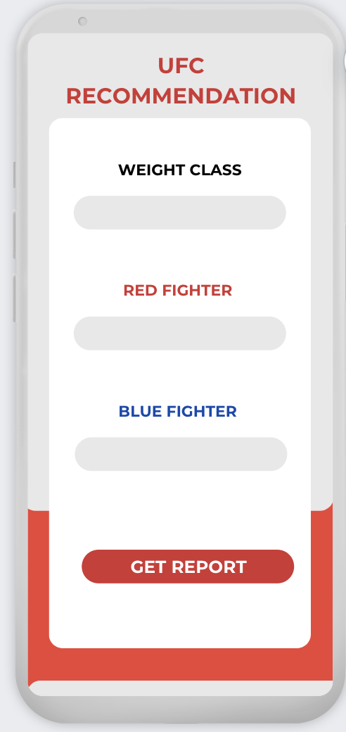
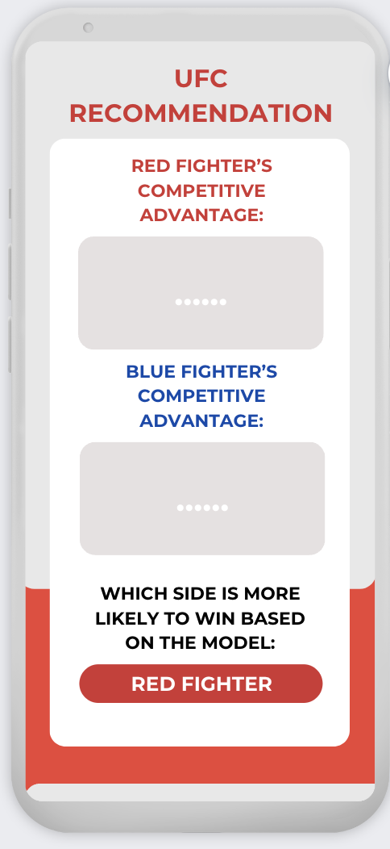
Enhance UFC Audience’s Engagement and Experience
Weight Class
INPUT
OUTPUT
Fighters’ Names

Slide 29
THANK YOU
ANY QUESTION?

